Slide 1
Employee data analysis using excel
STUDENT NAME: SHREE VARSHINI G
REGISTER NO : 312217961
NM ID : 1E180D29EBF1FBAAE284D0EDE62AB60F
DEPARTMENT : BCOM (ACCOUNTING AND FINANCE)
COLLEGE : ST. ANNE’S ARTS AND SCIENCE COLLEGE

Slide 2
PROJECT TITLE:
“ Employee Performance Analysis using Excel “

Slide 3
AGENDA
Project Statement
Project Overview
End Users
Our Solution and Proposition
Dataset Description
Modelling Approach
Results and Discussion
Conclusion

Slide 4
PROBLEM STATEMENT
This project aims to analyze employee performance based on satisfaction levels using Excel. The goal is to identify patterns and correlations within the data to help improve employee satisfaction and performance across different demographics and business units.

Slide 5
PROJECT OVERVIEW
The "Employee Performance Analysis Using Excel" project focuses on evaluating employee performance by analyzing key factors such as satisfaction levels, gender, and business unit. The project involves collecting and organizing employee data in Excel, followed by detailed analysis using statistical functions and data visualization tools. By identifying trends and correlations, the analysis will provide insights into how different factors impact performance across various demographics and departments. The findings will support data-driven decision-making to enhance employee satisfaction and optimize performance within the organization.

Slide 6





WHO ARE THE END USERS?
HR MANAGER
DEPARTMENT MANAGER
DATA ANALYST
EMPLOYEES
EXECUTIVE

Slide 7
OUR SOLUTION AND ITS VALUE PROPOSITION
CONDITIONAL FORMATTING
Highlighting cells that are blanks or have no value
FILTER: Focusing on blank cells and removing them
FORMULA: For identifying the age category from late 20s to early60s
PIVOT TABLE: Summarizing data and analyzing relationship and generating report
SLICER: Filtering data for enhancing user experience and highlight clear view of specific data
GRAPH: For data visualization

Slide 8
DATASET DESCRIPTION
Dataset Name: Employee Performance Analysis
DataDescription: Contains performance metrics for employees, including satisfaction scores, performance ratings, and demographic details.
Source: Edunet Foundation
Variables/Columns:
Name: First nameGender: Male and Female
Business Unit: BPC, CCDR, EW, MSC, NEL, PL, PYZ, SVG, TNS, WBL Employee Type: contract, Full time, Part time
Performance Rating: Very high, High, Medium, Low
Satisfaction Score: 1-5
Data Types: Numeric and Text
Units of Measurement:
Satisfaction score: Scale of 1-5Performance rating: Very high, High, Medium, Low
Size: 26 records, 5 fields

Slide 9
THE “WOW” IN OUR SOLUTION
FORMULA:
Performance level =IF(Z8>=5,"Very High",IF(Z8>=4,"High",IF(Z8>=3,"Medium",IF(Z8<=2,"Low"))))
INSIGHTS: Used to evaluate the scores as levels from low to very high.

Slide 10
MODELLING AND APPROACH
DATA COLLECTION:
Data source: Edunet Foundation
Dashboard Basis: Employee dataset
DATA PREPARATION:
Feature selection: Selected based on Performance
Features: First Name, Department, Gender code, performance level, Employee type
DATA CLEANING:
Conditional Formatting: Missing values was identified
DATA AGGREGATION:
Excel function: IFS function used for categorizing employees on the basis of their performance level
Performance level categories: 5 - Very high4 - High3 - Medium 2 &1 – Low

Slide 11
MODELLING AND APPROACH
DATA ANALYSIS:
Pivot table: Pivot table was generated to summarize data and cross tabulation ( performance level by department; Filtered by Gender)
Slicer: To filter/ slice the data to scrutinize and sort particular information (Employee type )
VISUALIZATION OF DATA:
Chart: Recommended charts (Column chart) was used
Chart Element: Chart title was added
Trendline: Linear and exponential line was used

Slide 12
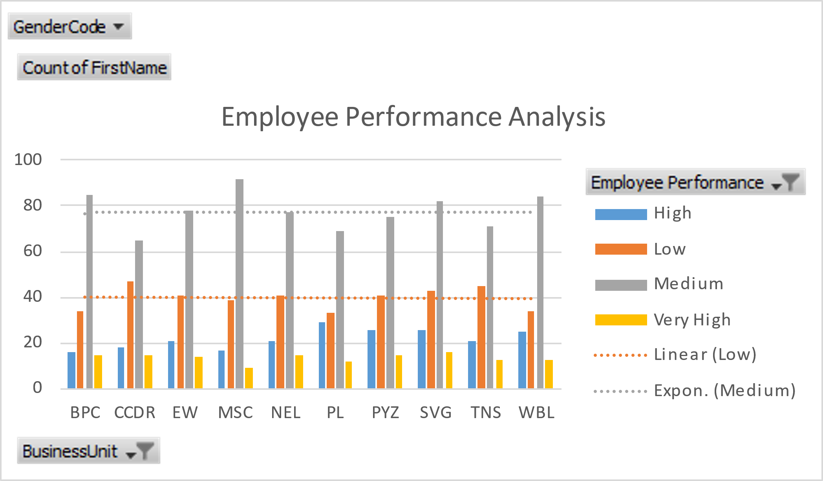
RESULT
COLUMN CHART

Slide 13
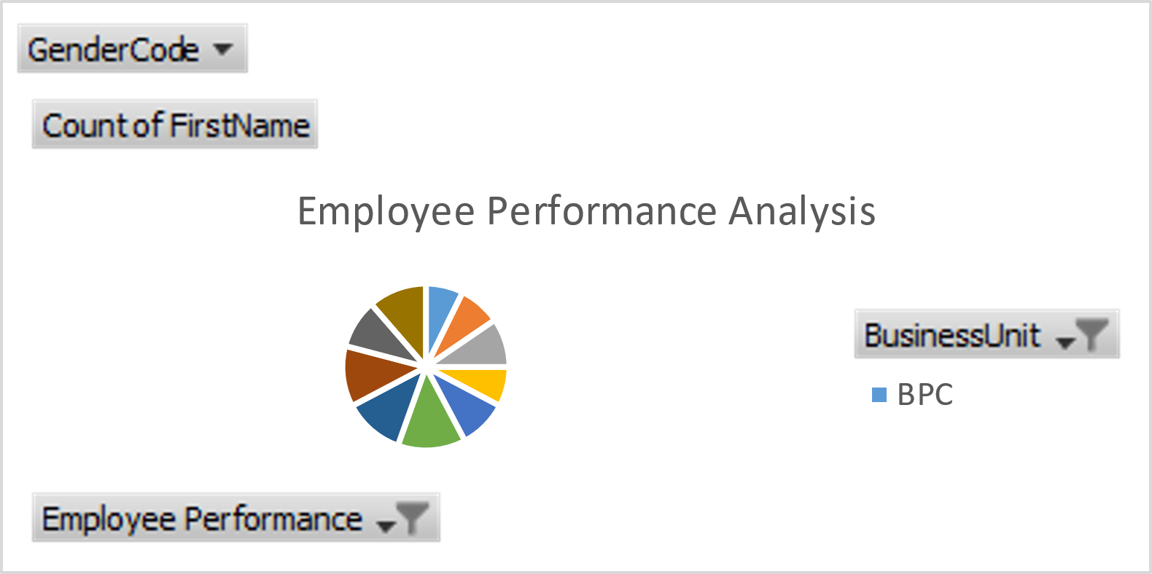
RESULT
PIE CHART

Slide 14
CONCLUSION
This project focuses on employee performance analysis conducted using Excel, it is evident that key performance indicators such as productivity, efficiency play a crucial role in overall performance. The analysis highlights top-performing employees and areas needing improvement. Recommendations include targeted training and better resource allocation. This approach can help enhance employee performance and achieve organizational goals more effectively.

